Slide 1
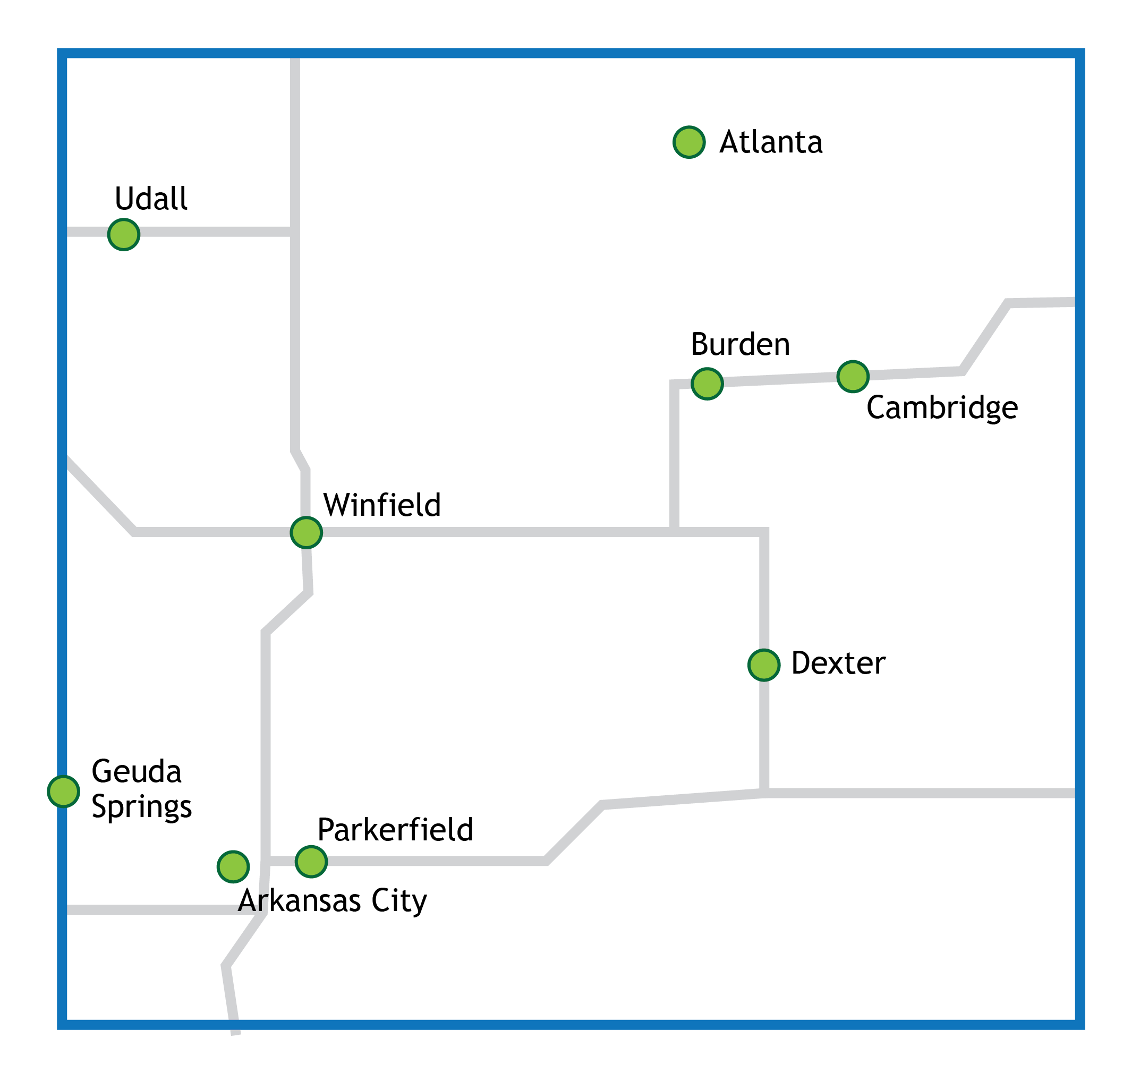
Cowley County Cities

Slide 2
Demographics

Slide 7
Socioeconomics

Slide 14
Risk and Protective Behaviors

Slide 24
Maternal and Child Health

Slide 33
Kansas Department of Health and Environment 2013-2014

Slide 35
Health Status and Chronic Disease

Slide 45
Mortality

Slide 55
Access

Slide 59
Cowley County Cities

Slide 60
Pre-Meeting Survey

Slide 61
Priority #1
Promote health, wellness, and chronic disease prevention.

Slide 64
Priority #1. Promote health, wellness, and chronic disease prevention.
 | Rating Average | % Who Agree or Strongly Agree
Priority #1: In general: Promote health, wellness, and chronic disease prevention. | 4.69 | 93.8%
1.1. Emphasize health education from cradle to grave. | 4.26 | 85.3%
1.2. Focus on youth, teaching healthy lifestyle behaviors that can be carried throughout life (e.g., hygiene, nutrition, exercise, etc.). | 4.62 | 97.1%
1.3. Help adults achieve healthier lifestyles (e.g., weight loss, tobacco cessation, responsible alcohol use). | 4.32 | 85.3%
1.4. Work to prevent cancer and other chronic disease incidence through lifestyle education and modification, and through promotion of appropriate screening practices. | 4.41 | 88.2%
1.5. Increase awareness and use of existing local services and providers thereby reducing health spending leakages. | 4.50 | 97.1%
1.6. Work with existing local institutions (e.g., school district, local governments, etc.) to collaborate with health and wellness education. | 4.59 | 100%

Slide 65
Priority #2
Enhance access to health service providers.

Slide 68
Priority #2. Enhance access to health service providers
 | Rating Average | Agree or Strongly Agree
Priority #2 Enhance access to health service providers | 4.52 | 93.5%
2.1. Health service provider recruitment and retention is a key component. | 4.47 | 97.1%
2.2. Issues of affordability affect access. Direct those eligible and in need toward available resources and assistance. | 4.53 | 97.1%
2.3. Enhance communication and collaboration across health service providers to ensure more complete case management. | 4.50 | 91.2%
2.4. Support options for access to care for the medically underserved. | 4.44 | 97.1%

Slide 69
Q3
Looking ahead, do you think any updated priorities should be similarly broad, or should they be more specific?

Slide 71
Additional Comments:
Changes to lifestyle are the key to improved health - hoping that #1 will be further emphasized and translated into specific impactful initiatives
The FQHC is now open but little is known about what has occurred there.
Priorities should be broad, as they provide guidance for more specific directives.
Identify specifics to promote and accomplish achievable plan
It depends on the action plan
Consider CHIP goals during this second round of CHA development

Slide 72
Looking ahead, do you think any updated priorities should be similarly broad, or should they be more specific?
 | Response Percent
New or updated priorities should be similarly broad or encompassing as the current priorities | 14.7%
New or updated priorities should be somewhat more specific than the current priorities | 47.1%
New or updated priorities should be significantly more specific than the current priorities | 5.9%
No preference | 14.7%
Additional comments: | 17.6%

Slide 73
Q4
In terms of being prioritized for a coordinated, concerted effort over the next 3 years with focused attention, time and resources, how high of a priority for Cowley County is each issue related to HEALTHY LIFESTYLES?

Slide 76
In terms of being prioritized for a coordinated, concerted effort over the next 3 years with focused attention, time and resources, how high of a priority for Cowley County is each issue related to HEALTHY LIFESTYLES?
 | Rating Average | Agree or Strongly Agree
Alcohol and Drug Abuse | 4.18 | 78.8%
Community Culture of Wellness (other than nutrition and physical activity) | 3.85 | 64.7%
Community Gardens | 3.03 | 29.4%
Farmers' Markets | 3.50 | 44.1%
Healthy Eating | 4.35 | 88.2%
Healthy Environment (clean water, clean air, etc.) | 3.71 | 73.5%
Obesity | 4.53 | 96.9%
Physical Activity for Adults | 4.39 | 90.9%
Physical Activity for Children and Youth | 4.36 | 87.9%
Tobacco Use | 4.09 | 75.8%
Trails and Pathways | 4.00 | 71.9%
Violence | 3.76 | 67.6%
Workplace Wellness Employer-Offered Wellness Incentives | 3.91 | 72.7%

Slide 77
Other very high priority issues(s) related to healthy lifestyles:
Smoking cessation, prenatal and postnatal care for mothers and infant children.
Access to consistent preventative health maintenance.
It would be nice to have no cost/safe options for exercise in our community. It would fit well with focus on physical activity for adults, workplace wellness and obesity initiatives.
Safe sidewalks and way to walk around towns.

Slide 78
Q5
In terms of being prioritized for a coordinated, concerted effort over the next 3 years with focused attention, time and resources, how high of a priority for Cowley County is each issue related to ACCESS AND HEALTH SERVICES?

Slide 81
In terms of being prioritized for a coordinated, concerted effort over the next 3 years with focused attention, time and resources, how high of a priority for Cowley County is each issue related to ACCESS AND HEALTH SERVICES?
 | Rating Average | Agree or Strongly Agree
Health Screenings | 4.06 | 76.5%
Mental Health | 4.29 | 82.4%
Oral Health | 3.79 | 70.6%
Pharmaceuticals/Medications (Affordable, Accessible) | 4.06 | 79.4%
Surgical Services | 3.56 | 50.0%
Long-Term Care, Nursing Care, Assisted Living | 3.58 | 57.6%
Regional Approach to Healthcare Provider & System Access | 3.68 | 52.9%
Coordination/integration of Mental, Physical, and Oral Health Services | 4.15 | 73.5%
Access for Underserved | 4.32 | 91.2%
Lack of Health Care Coverage or Underinsurance | 4.21 | 87.9%
Transportation | 3.71 | 67.6%
Healthcare Marketplace Navigation and Education | 3.84 | 68.8%
Educate Employers, Improve Insurance/ Plans/ Self-Insurance through Employers | 3.61 | 45.5%

Slide 82
Other very high priority issues(s) related to access and health services:
Access/communication needs regarding healthcare for persons with English as a second language.
The availability of medical doctors and dentists who will accept new patients and patients with KanCare or no health insurance.

Slide 83
Q6
In terms of being prioritized for a coordinated, concerted effort over the next 3 years with focused attention, time and resources, how high of a priority is each issue related to CHRONIC DISEASES, LEADING CAUSES OF DEATH, or OTHER HEALTH PROBLEMS for Cowley County?

Slide 86
In terms of being prioritized for a coordinated, concerted effort over the next 3 years with focused attention, time and resources, how high of a priority is each issue related to CHRONIC DISEASES, LEADING CAUSES OF DEATH, or OTHER HEALTH PROBLEMS for Cowley County?
 | Rating Average | Agree or Strongly Agree %
Cancer | 4.00 | 72.7%
Diabetes | 4.41 | 94.1%
Heart Disease | 4.48 | 93.9%
Cerebrovascular Disease (Stroke) | 4.09 | 78.1%
Chronic Lower Respiratory Disease | 3.79 | 69.7%
Suicide | 3.68 | 52.9%
Injuries | 3.33 | 45.5%
Motor Vehicle Accidents/Traffic Injuries | 3.30 | 39.4%
Mental Health, Depression, or Anxiety | 4.18 | 82.4%

Slide 87
Other very high priority issues(s) related to chronic diseases, leading causes of death or other health problems:
Drug abuse
Lowering our incidence of diabetes needs to be a focus. Diabetes education is also valuable so that patients don't have the costly side effects including hospital admissions that come from lack of control.
Mental health is a large problem however the problem lies in what can we do about it?

Slide 88
Q7
In terms of being prioritized for a coordinated, concerted effort over the next 3 years with focused attention, time and resources, how high of a priority is each issue related to MATERNAL AND CHILD HEALTH for Cowley County?

Slide 91
In terms of being prioritized for a coordinated, concerted effort over the next 3 years with focused attention, time and resources, how high of a priority is each issue related to MATERNAL AND CHILD HEALTH for Cowley County?
 | Rating Average | Agree or Strongly Agree
Adequate Prenatal Care | 4.50 | 91.2%
Infant Mortality | 3.91 | 63.6%
Teen Pregnancy | 4.18 | 85.3%
Smoking During Pregnancy | 4.21 | 70.6%
Breastfeeding | 3.97 | 64.7%
Immunizations | 4.41 | 85.3%

Slide 92
Other very high priority issues(s) related to maternal & child health:
Injuries and death due to child abuse
I think that the incidence of infant mortality may be linked to inadequate prenatal care. I am not sure of the incidence of deliveries without any prenatal care, but I would think that many problems could be identified with prenatal care.

Slide 93
Q8
Which statement best describes what you think the priorities should be going forward?

Slide 95
Which statement best describes what you think the priorities should be going forward?
 | Response Percent
Keep the current priorities and continue to work on them | 12.1%
Keep the current priorities but refine/change strategies or objectives under those priorities, as needed | 54.5%
Refine or update the current priorities themselves | 24.2%
Add an additional priority | 0.0%
Make the priorities more specific | 18.2%
Start from a "blank slate" and consider new priorities | 0.0%

Slide 96
Other Comments:
The health care arena is changing almost daily. We must be aware of the change and adapt goals to those changes.
Are there bullet points of what is to be addressed and accomplished on each priority? They seem rather broad without that information and what was worked on since the last assessment.

Slide 97
Q9
Thinking about the current priorities, strategies under those priorities, other potential priorities mentioned in this survey, as well as your own knowledge of the community, what do you think the new health priorities should be going forward? List no more than three. They may be broad or specific.

Slide 98
First priority: | Second priority: | Third priority:
Reduce obesity | Reduce smoking | Improve childhood diet & exercise
Obesity prevention | Nutrition | Mental health care
Address obeisity as it affects/contributes to other conditions | Reduce smoking/tobacco use | Emphasize wellness in mothers -infants
Affordable medications and education regarding meds and disease process/treatments | Education regarding top chronic diseases | Prevention/Risk factors of many major chronic diseases.
Promote healthy lifestyles to youth through activities and food | Encourage healthy lifestyle changes for adults | Enhance access to healthcare through recruitment, retention and a variety of services.
health care | drug and alcohol treatment | children and healthy ways to live
Help each Cowley County community to identify specific policy, system or environmental change to create culture of wellness/health.
Explain clear usage of Community Health Ctr to public | Create a public awareness of all providers & services | Explain communications between agencies, providers & public
Sharing of EHRs across all professions that share in the treatment of patients. | Enhance availability of access to health care | Promo health, wellness, and prevention
acess to health care for underinsured or those on KanCare | drug and alcohol abuse prevention/awareness | education on prevention of abuse/child & domestic
mental health for all ages | family health and wellness (physical and emotional)
Diabetes education (decreasing co-morbidites & prevention) | mental health (Do we have resources in the community?) | Options for low cost/free fitness-- i.e. walking/biking trails
Affordable care | Parenting and child deaths | Mental Health
Health Prevention | Mental Health | Obesity
Diabetes | Heart Disease | Pregnancy/Breastfeeding
Increase access to healthy foods | Increase access to physical activity opportunities | Decrease rates of tobacco use among youth and adults
Physical activity | Mental illness | Prenatal care
Maternal health | Mental health | physical activity amongst children and adults
Wellness | Obesity | Healthy Food Access

Slide 99
1st priority:
Reduce obesity
Obesity prevention
Address obesity as it affects/contributes to other conditions
Affordable medications and education regarding meds and disease process/treatments
Promote healthy lifestyles to youth through activities and food
health care
Help each Cowley County community to identify specific policy, system or environmental change to create culture of wellness/health.
Explain clear usage of Community Health Center to public
Sharing of EHRs across all professions that share in the treatment of patients.
Access to health care for underinsured or those on KanCare
mental health for all ages
Diabetes education (decreasing co-morbidities & prevention)
Affordable care
Health Prevention
Diabetes
Increase access to healthy foods
Physical activity
Maternal health
Wellness

Slide 100
2nd priority:
Reduce smoking
Nutrition
Reduce smoking/tobacco use
Education regarding top chronic diseases
Encourage healthy lifestyle changes for adults
Drug and alcohol treatment
Create a public awareness of all providers & services
Enhance availability of access to health care
Drug and alcohol abuse prevention/awareness
Family health and wellness (physical and emotional)
Mental health (Do we have resources in the community?)
Parenting and child deaths
Mental Health
Heart Disease
Increase access to physical activity opportunities
Mental illness
Mental health
Obesity

Slide 101
3rd priority:
Improve childhood diet & exercise
Mental health care
Emphasize wellness in mothers -infants
Prevention/Risk factors of many major chronic diseases.
Enhance access to healthcare through recruitment, retention and a variety of services.
Children and healthy ways to live
Explain communications between agencies, providers & public
Promo health, wellness, and prevention
Education on prevention of abuse/child & domestic
Options for low cost/free fitness i.e. walking/biking trails
Mental Health
Obesity
Pregnancy/Breastfeeding
Decrease rates of tobacco use among youth and adults
Prenatal care
Physical activity amongst children and adults
Healthy Food Access

Slide 102
First Priority | # of votes | Second Priority | # of votes | Third Priority | # of votes
Physical Activity, Nutrition & Obesity | 6 | Physical Activity, Nutrition & Obesity | 3 | Physical Activity, Nutrition & Obesity | 5
Access / Health Care | 4 | Access / Health Care | 2 | Access / Health Care | 2
Mental Health | 1 | Mental Health | 5 | Mental Health | 2
Maternal & Child Health | 1 | Maternal & Child Health | 1 | Maternal & Child Health | 5
Chronic Disease | 2 | Chronic Disease | 2 | Chronic Disease | 1
Info & Data Sharing | 1 | Tobacco | 2 | Tobacco | 1
Medication | 1 | Alcohol | 2 | Access - Communication & Coordination | 1
Policy, Systems, Environment | 1 | Healthy Lifestyles | 1
Wellness & Prevention | 2

Slide 103
Q10
What community do you represent?

Slide 104
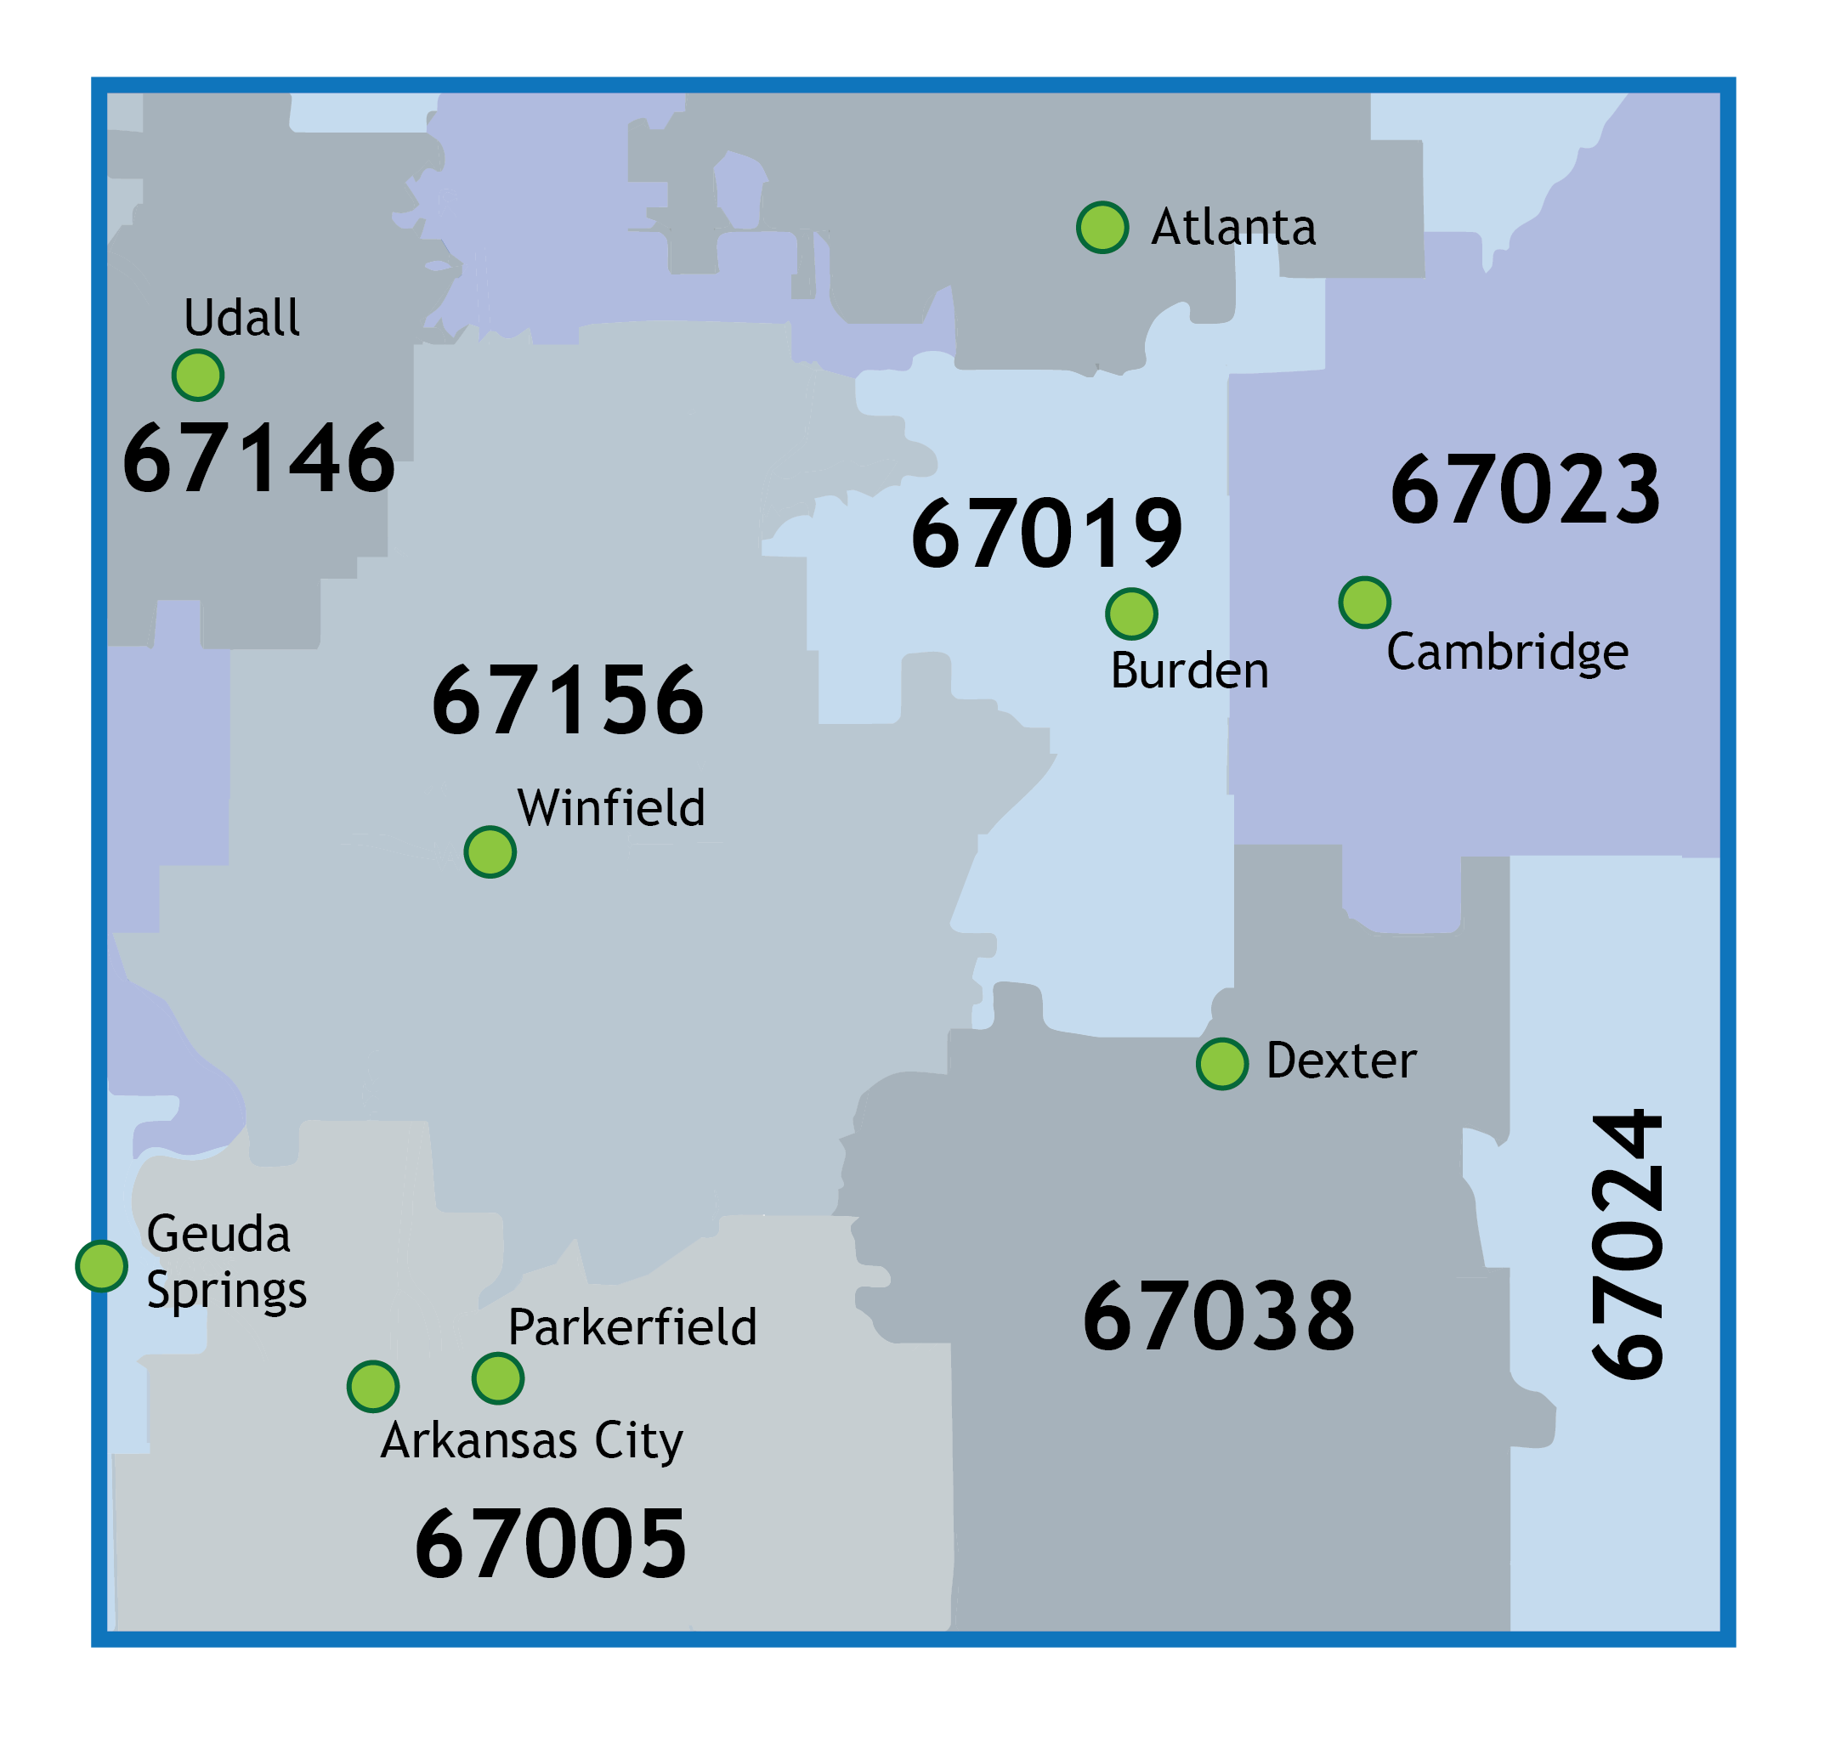
Respondents' Work & Home Zip Codes
21 Work
21 Home
1 Home
2 Work*
1 Home*
2 Work
3 Home
*City associated with zip code 67024 is Cedar Vale, Chautauqua County

Slide 105
Q11
Additional Comments

Slide 106
Other Comments:
None - other than would like to assure these priorities are translated into tangible actions with metrics to gauge progress. It is distressing/shameful that Cowley County is one of the least healthy areas of Kansas.
Improved education for adults over 18 years of age on knowledge of physical and mental health and wellness.
thank you!

Slide 107
Community Health Improvement Plan Review

