Slide 1
WOrk
2015 County Health Needs Assessment Review
Health Department Perspectives
Presented by
Tom Langer, MPA
Administrator/Public Health Officer
City-Cowley County Health Department
tlanger@cowleycounty.org

Slide 2
Cowley County rated “poor” in health outcomes.
Annual assessments conducted by RWJ and KHI consistently rank Cowley County in the bottom 20% of all Kansas counties in key health indicator areas.

Slide 3
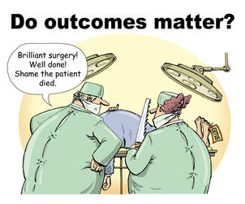
Health Outcomes…
A measurable change in personal health
as an individual or member of a group,
brought about by discrete intervention(s).
i.e. personal habits good & bad acute or chronic illness

Slide 4
Key indicators in Cowley County
38% Adult Obesity Rate
21% Adults who smoke
23% Pregnant mothers smoke
11% Adults diagnosed diabetic
65% Infants fully immunized by 24 months
54% Adults 65+ immunized against influenza
19% Adults report fair/poor health status
*Kansas Health Matters

Slide 5
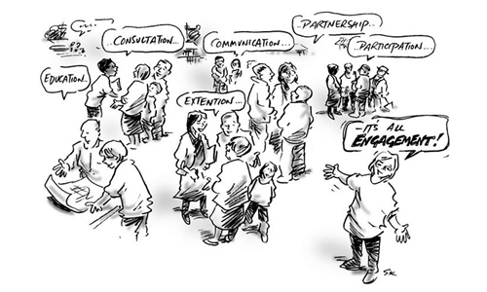
Health Department Role
Prevent – Promote – Protect
A vital and valued health department is engaged in the entire community
Trusted by all to provide quality service and health improvement methodologies
Services must meet the needs of the community
Not just a place that disadvantaged people visit for health care
Immunizations
Women's Health
Child Care Licensing
WIC
Kan Be Healthy – Child Health Assessment
Healthy Start – Newborn Home Visits
Safe Kids
Chronic Disease Risk Reduction
Communicable Disease Control
Adult/Senior Screening
Environmental Health
Emergency Preparedness

Slide 7
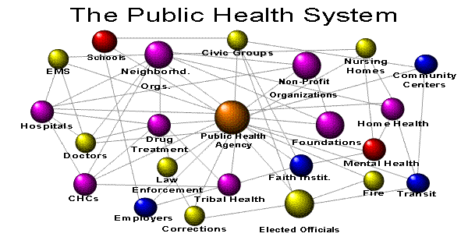

Slide 8
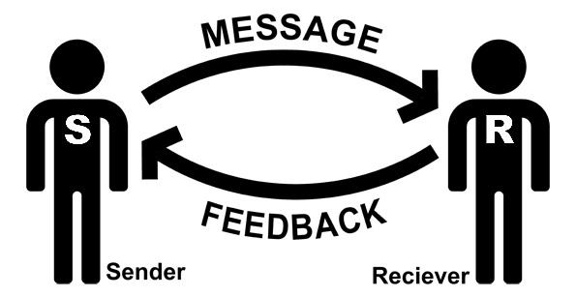
Communications
Wellness is not just a mission – it’s a message! How you deliver it can make all the
Difference. Sensitivity, creativity and media diversity are the cornerstones.

Slide 9
Outcomes
Better Health
Improved Quality of Life
Reduced Expense for Health Care
Greater Productivity
Healthy Community

Slide 10
Next Steps
Determine top 2-3 community health needs priorities
Identify Strategies that can meaningfully impact those priorities
Coordinate in the community to focus efforts and move forward

Slide 11
Comments/Questions?
Thank you for all your help today!
City-Cowley County Health Department
@Cowleyhealth

